Slide 1
Image and Video Processing

Slide 2
考核
1. 随堂测验：时间18-20周某节课
2. 期末大作业：视频风格迁移
要求
(1) 最多3人一组
(2) 口头汇报 (PPT+程序演示)，每组5分钟， 时间：19-20周
(3) 提交材料 (论文+代码) ，时间：20周周日
(4) 成员贡献明确，且按贡献排序

Slide 3
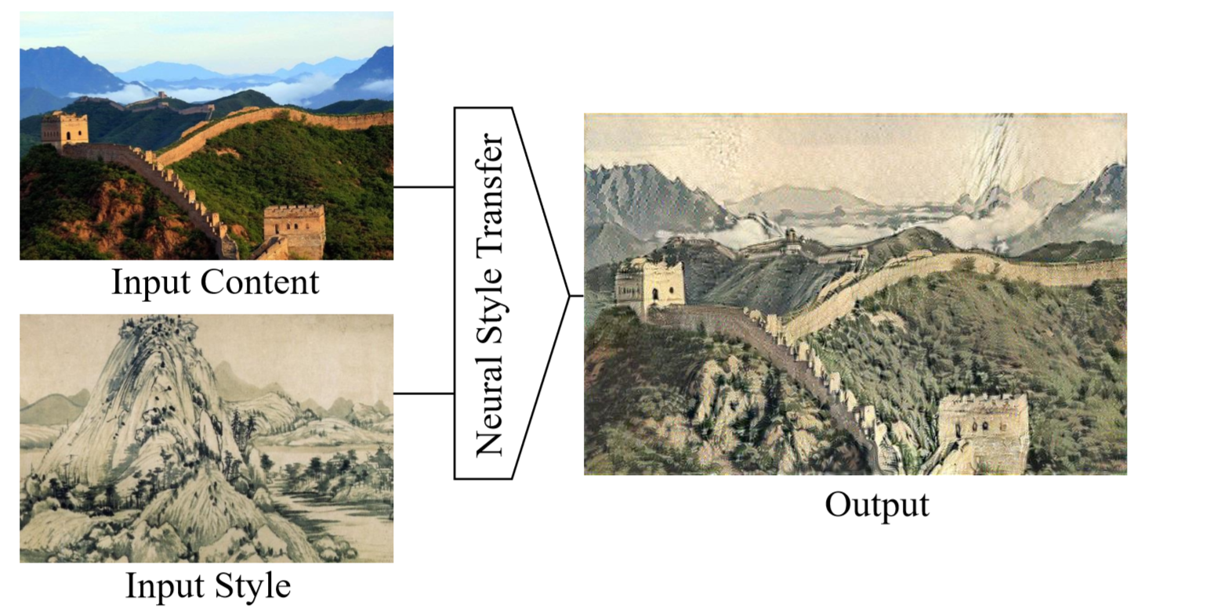
Video style transfer
The process to render a content image in different styles.
Notes:
风格图是富春山居图

Slide 4

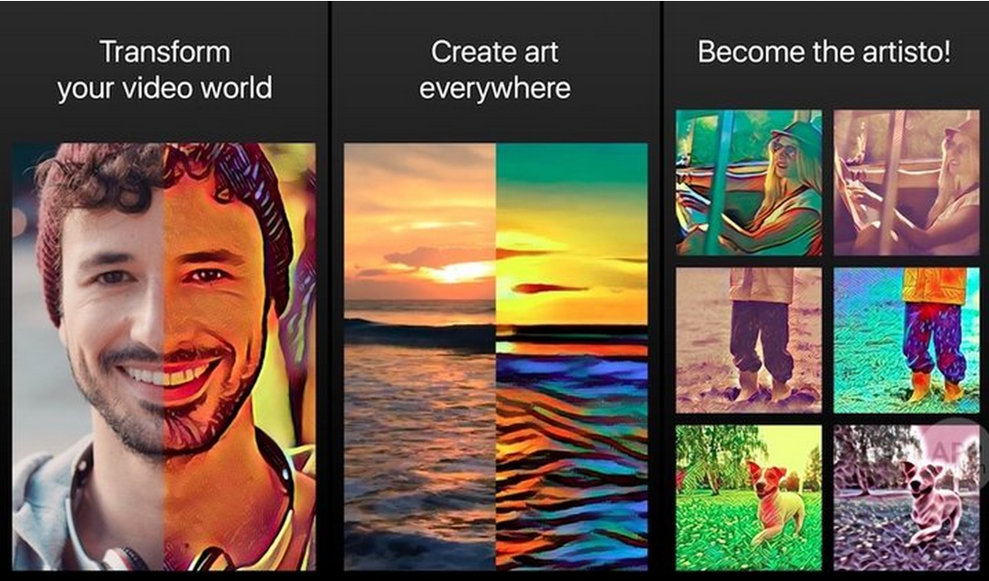
Video style transfer: Applications
Social Communication
User-assisted Creation Tools
Production Tools for Entertainment Applications
Notes:
风格图是富春山居图

Slide 5

Video style transfer: a demo

Slide 6
Some materials
Survey, papers and codes: https://github.com/ycjing/Neural-Style-Transfer-Papers

Slide 7
III.3 Morphological Filtering for Image Enhancement and Detection
1 Introduction
2 Morphological Image Operators
3 Morphological Filters for Enhancement
4 Morphological Filters for Detection

Slide 8
1 Introduction
The goals of image enhancement
Improve the visibility and perceptibility of the various regions into which an image can be partitioned and detectability of the image features inside these regions
Cleaning the image from various types of noise
Enhancing the contrast among adjacent regions or features
Simplifying the image via selective smoothing or elimination of features at certain scales

Slide 9

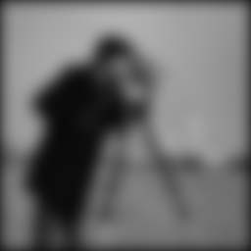
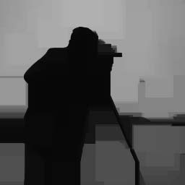
1 Introduction
original
Gaussian Linear convolutions
Morphological clos-openings
Mathematical morphology
A set- and lattice-theoretic methodology for image analysis, which aims at quantitatively describing the geometrical structure of image objects

Slide 10
1 Introduction
Morphological image processing
A broad and coherent collection of theoretical concepts, nonlinear filters, design methodologies, and applications systems
Preserve, uncover, or detect the geometric structure of image object
Offer efficient solutions to other nonlinear tasks such as non-Gaussian noise suppression

Slide 11
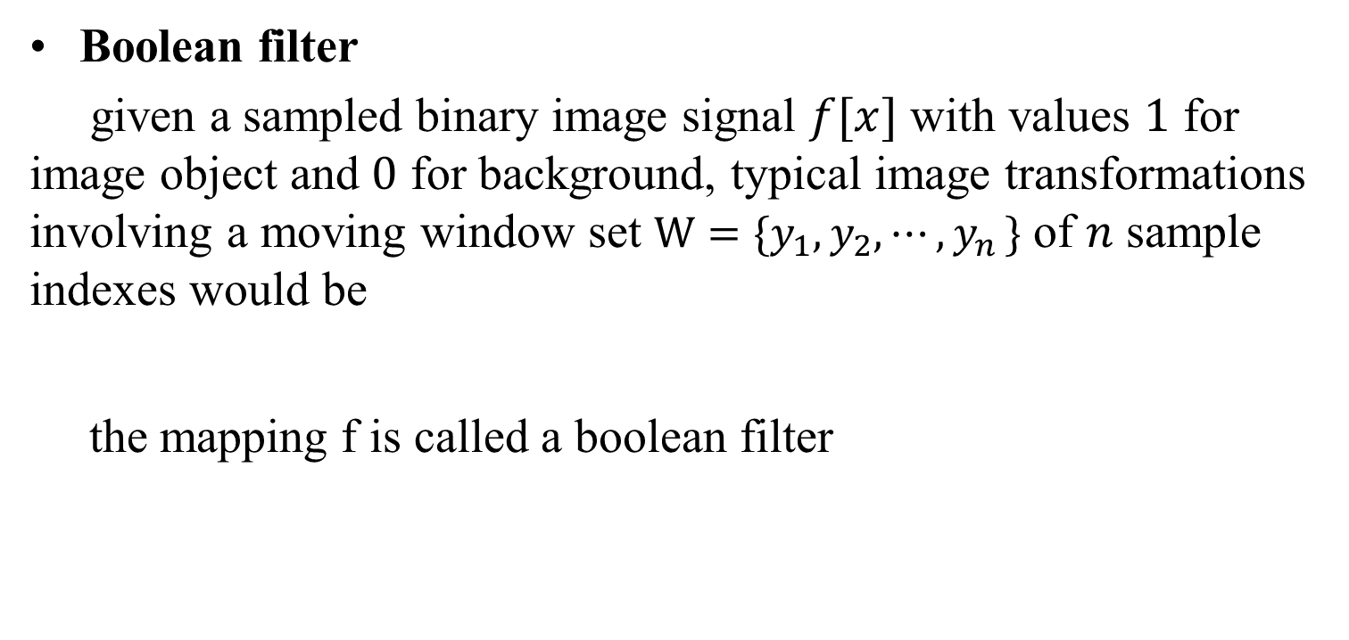
2 Morphological Image Operators 2.1 Morphological Filters for Binary Images
Boolean filter
given a sampled binary image signal $f[x]$ with values $1$ for image object and $0$ for background, typical image transformations involving a moving window set $W=\{y_{1},y_{2},⋯{,y}_{n}\}$ of $n$ sample indexes would be
the mapping f is called a boolean filter

Slide 12
2 Morphological Image Operators 2.1 Morphological Filters for Binary Images
Dilation
the Boolean OR transformation of X by a (window) set B
where is the translation of X along the vector y
Notes:
Di’lation: 扩大、膨胀操作

Slide 13
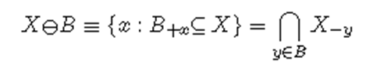
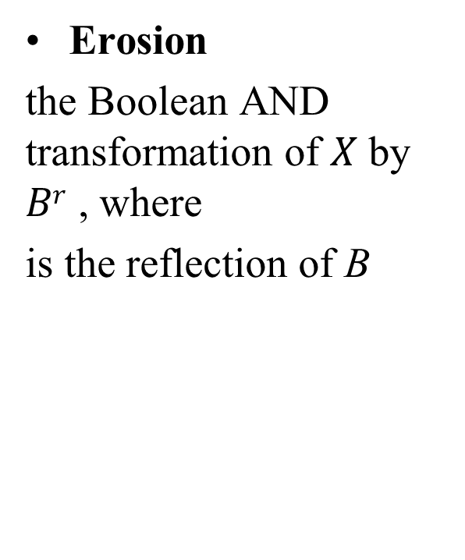
2 Morphological Image Operators 2.1 Morphological Filters for Binary Images
Erosion
the Boolean AND transformation of $X$ by $Br$ , where
is the reflection of B
Notes:
E’rosion: 腐蚀操作

Slide 15
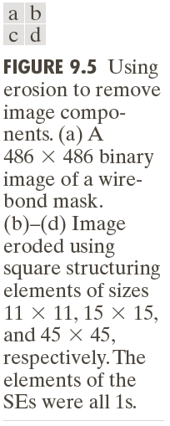

Slide 16
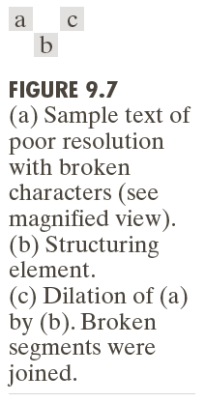

Slide 17
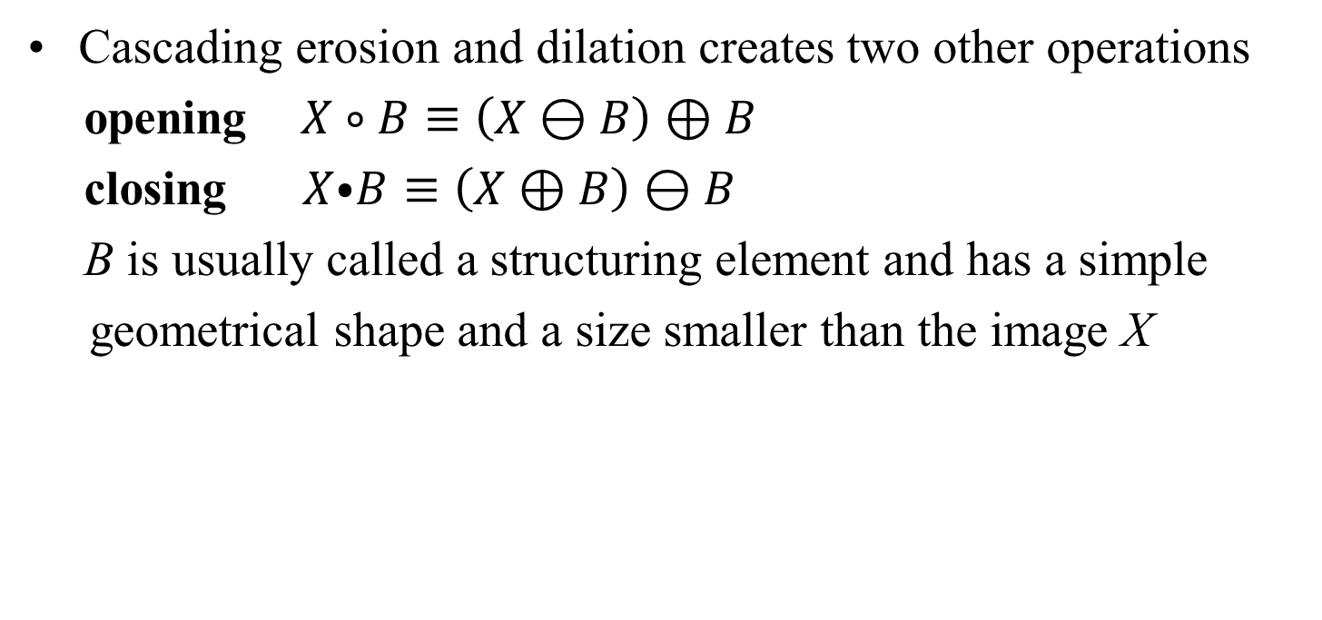
2 Morphological Image Operators 2.1 Morphological Filters for Binary Images
Cascading erosion and dilation creates two other operations
opening $X∘B≡\left(X⊖B\right)⊕B$
closing $X⦁B≡\left(X⊕B\right)⊖B$
B is usually called a structuring element and has a simple
geometrical shape and a size smaller than the image X

Slide 18
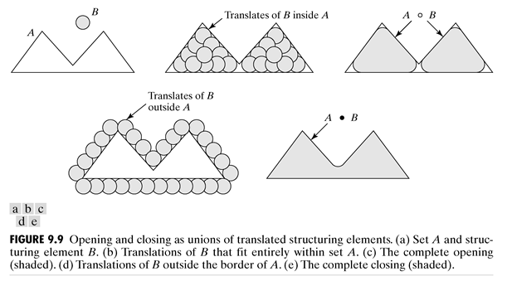
2 Morphological Image Operators 2.1 Morphological Filters for Binary Images

Slide 19
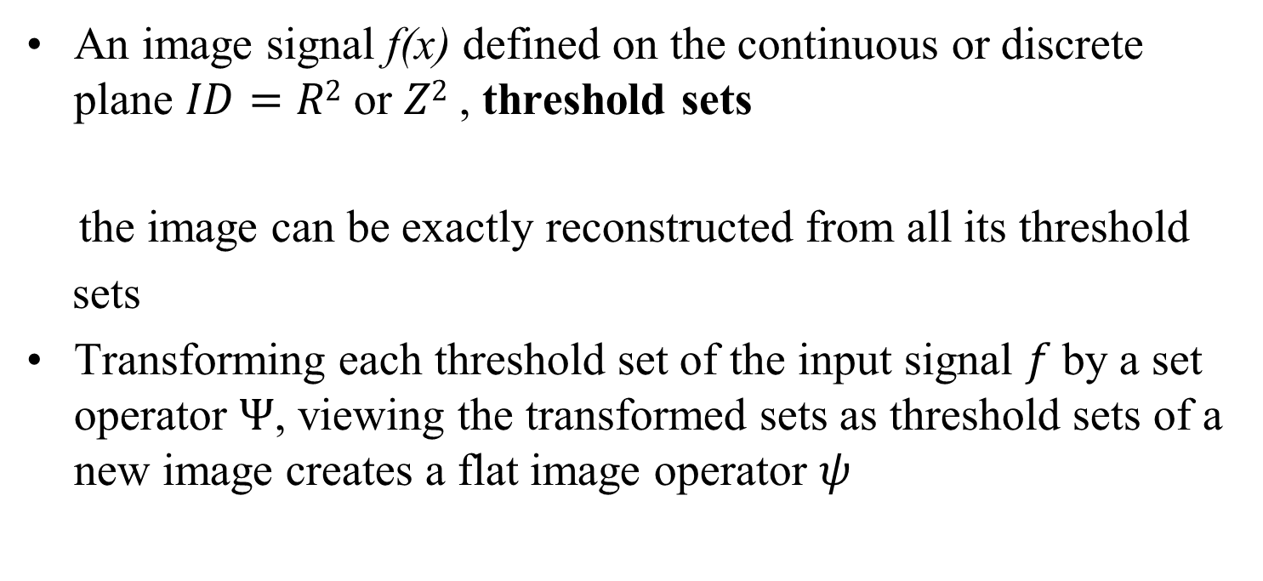
2 Morphological Image Operators 2.2 Morphological Filters for Graylevel Images
An image signal f(x) defined on the continuous or discrete plane $ID=R2$ or $Z2$ , threshold sets
the image can be exactly reconstructed from all its threshold
sets
Transforming each threshold set of the input signal $f$by a set operator $Ψ$, viewing the transformed sets as threshold sets of a new image creates a flat image operator $ψ$

Slide 20
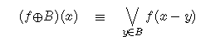
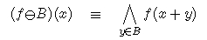
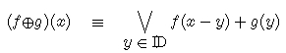
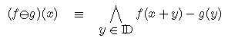
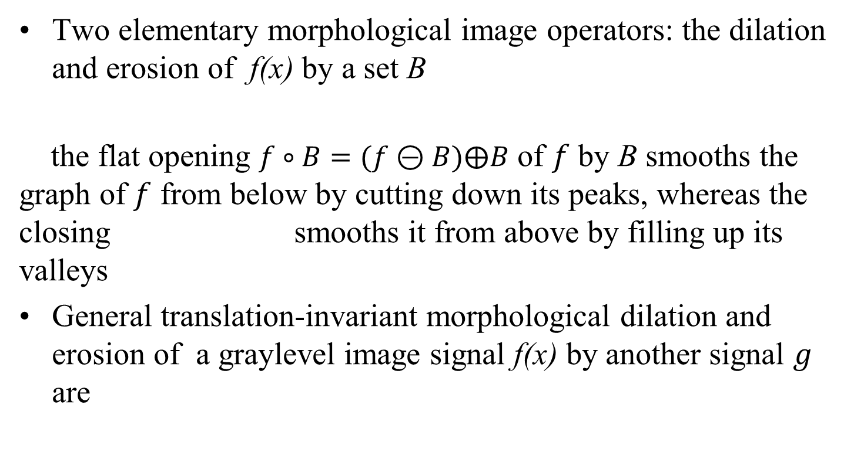
2 Morphological Image Operators 2.2 Morphological Filters for Graylevel Images
Two elementary morphological image operators: the dilation and erosion of f(x) by a set B
the flat opening $f∘B=(f⊝B)⨁B$ of $f$ by B smooths the graph of $f$ from below by cutting down its peaks, whereas the closing smooths it from above by filling up its valleys
General translation-invariant morphological dilation and erosion of a graylevel image signal f(x) by another signal $g$ are

Slide 21
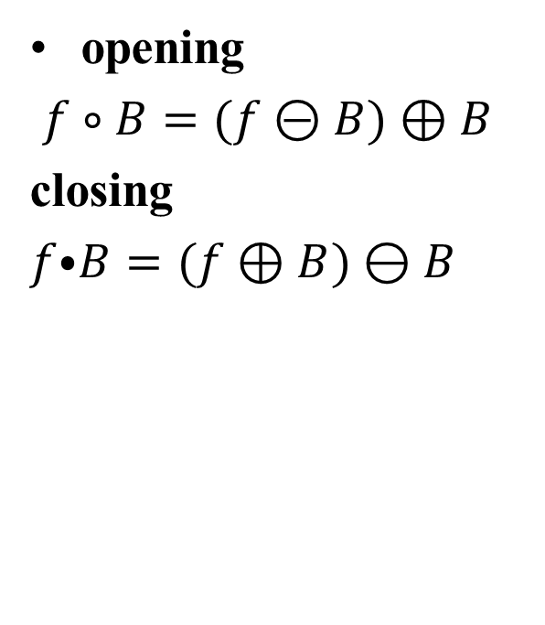
2 Morphological Image Operators 2.2 Morphological Filters for Graylevel Images
opening
$f∘B=(f⊝B)⊕B$
closing
$f⦁B=(f⊕B)⊖B$

Slide 22
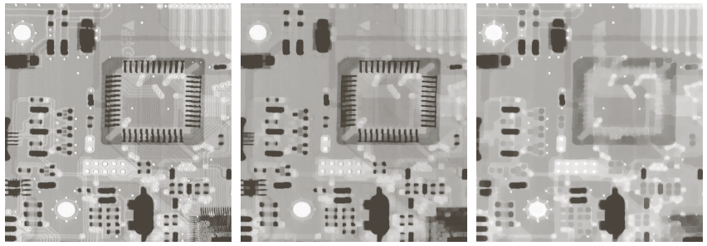
2 Morphological Image Operators 2.2 Morphological Filters for Graylevel Images

Slide 23
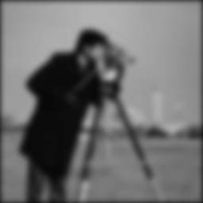


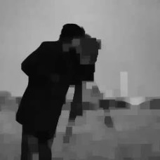
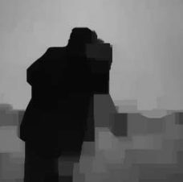

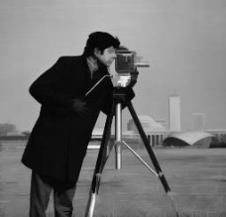
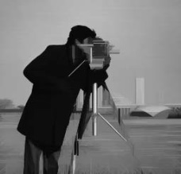
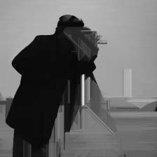
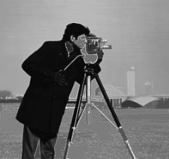
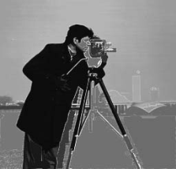
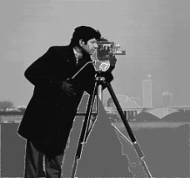
3 Morphological Filters for Enhancement 3.1 Image Smoothing or Simplification
Multiscale Morphological Smoothers
Gaussian linear convolutions
Morphological clos-openings
Morphological radial clos-openings
Morphological clos-openings by reconstruction
Scale=8
Scale=16
Scale=32

Slide 24
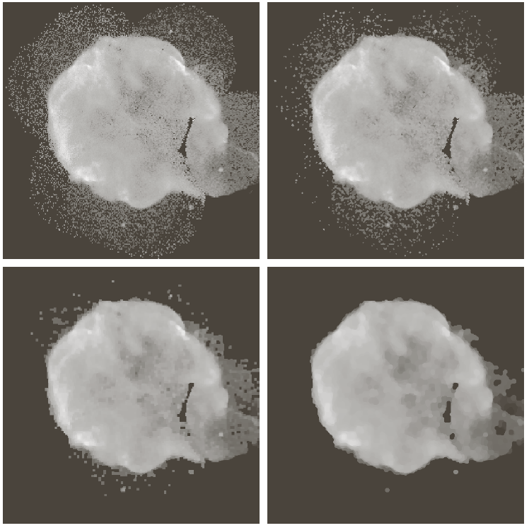
3 Morphological Filters for Enhancement 3.1 Image Smoothing or Simplification

Slide 25
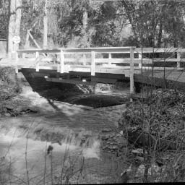



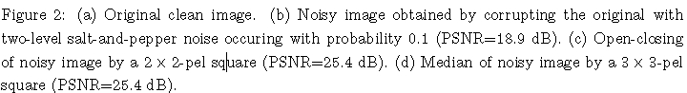
3 Morphological Filters for Enhancement 3.1 Image Smoothing or Simplification
Noise Suppresion by Median and Alternating Sequential Filters
(a)
(b)
(c)
(d)

Slide 26
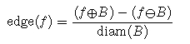
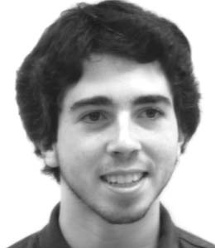
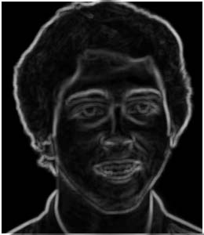
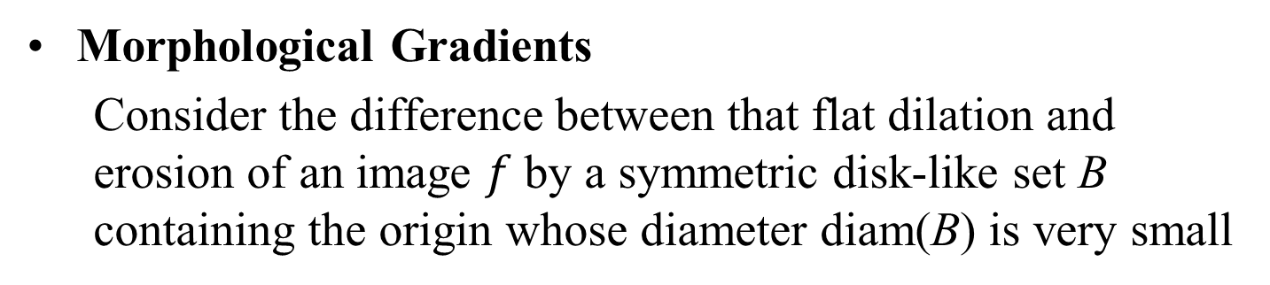
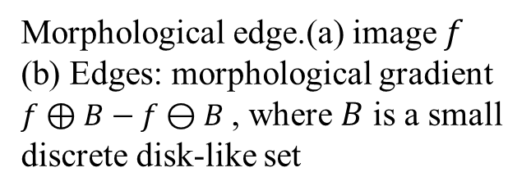
3 Morphological Filters for Enhancement 3.2 Edge or Contrast Enhancement
Morphological Gradients
Consider the difference between that flat dilation and erosion of an image $f$ by a symmetric disk-like set B containing the origin whose diameter diam(B) is very small
Morphological edge.(a) image $f$ (b) Edges: morphological gradient $f⊕B−f⊖B$ , where $B$ is a small discrete disk-like set
(a)
(b)

Slide 27
3 Morphological Filters for Enhancement 3.2 Edge or Contrast Enhancement

Slide 28
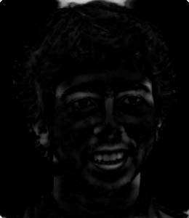
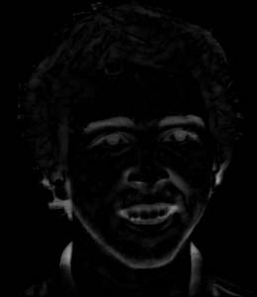
4 Morphological Filters for Detection Morphological Peak/Valley Feature Detection
Residual between opening or closings and the original image offer an intuitively simple and mathematically formal way for peak or valley detection
Top-hat transformation:
Valley detector:
(a)
(c)
(d)
Morphological blob detectors. (a) image $f$ (c) Peaks: $f−f∘B$ (d) Valleys : $f⦁B−f$

Slide 29
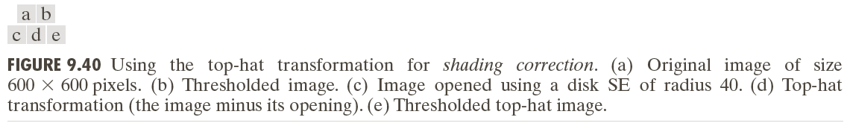
4 Morphological Filters for Detection Morphological Peak/Valley Feature Detection

